Slide 1

The artillery ammunition
Made by: Senior instr. lt.col. Marian-Cristian ENE

Slide 2
CONTENT
Questions
The classification
Ammunition arhitecture
Artillery ammunitions for guns

Slide 3
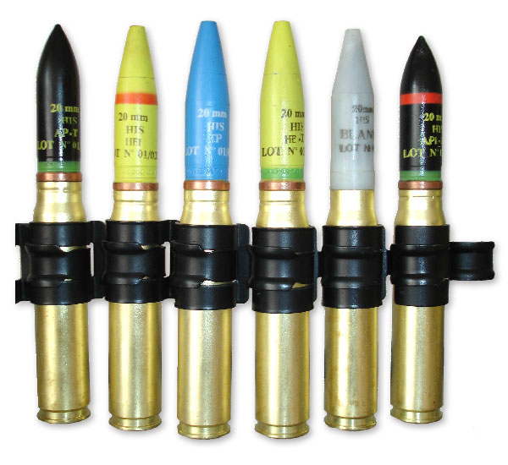
Classification
By purpose
By structure

Slide 4
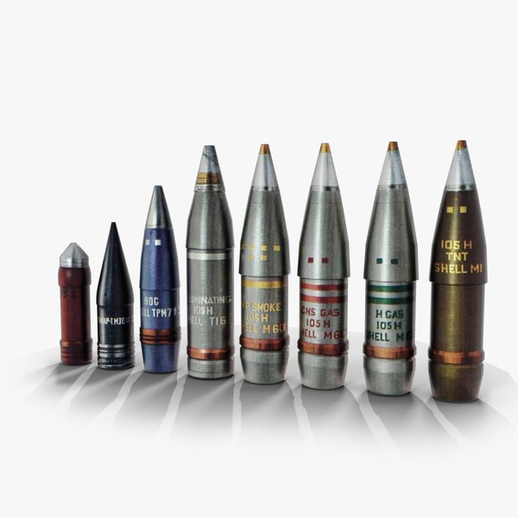
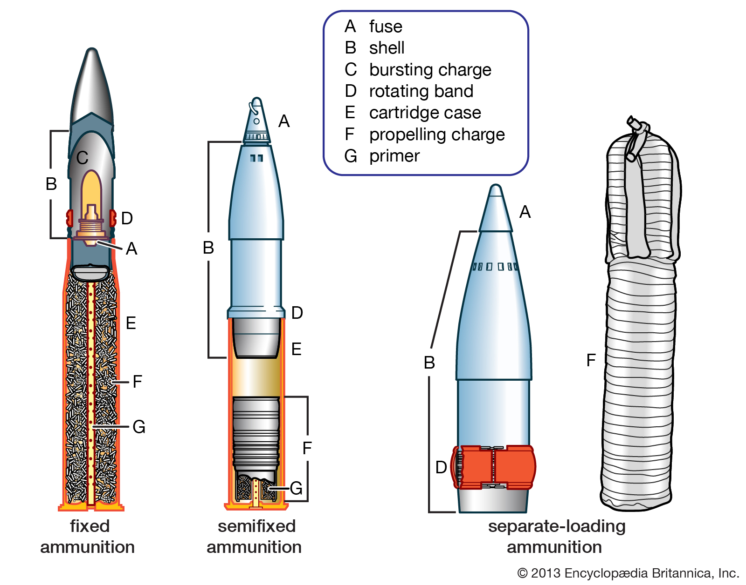
Ammunition architecture
a. The projectile
b. Cartridge Tube
c. Throwing charge and auxiliary items
d. Auxiliaries

Slide 5
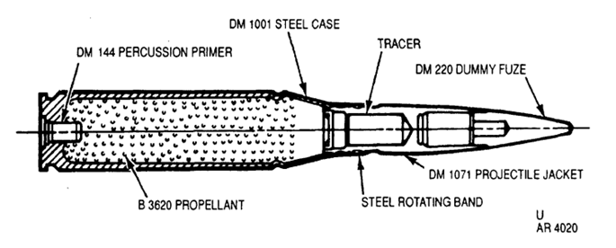
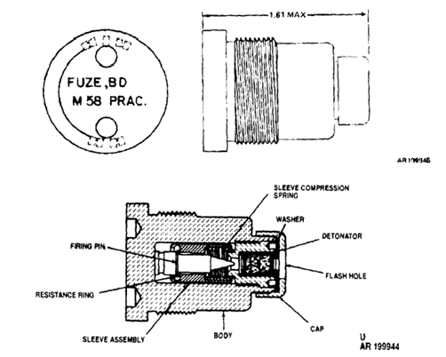
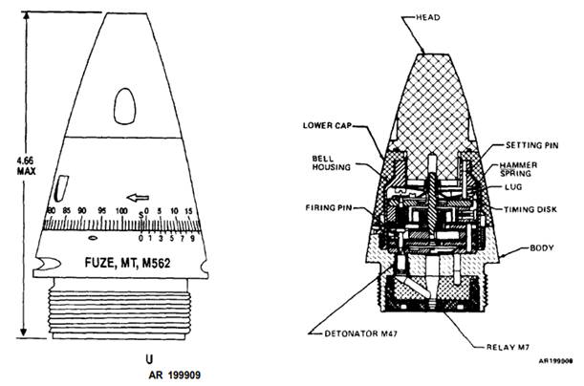
Artillery ammunitions for guns

Slide 6
CONCLUSION
There is a diversity in the field of anti-aircraft artillery ammunition, and these must be known for maximum efficiency in the tactical field.

Slide 7

THANK YOU FOR YOUR ATTENTION!
QUESTIONS?

